Slide 1

Developing a Crypto Trading Strategy Leveraging On-Chain Data
Togay Atmaca – 12268957
Jordan Cassella – 12452926
Matthew Haimes – 12452937
Kunj Shah – 12258505
Yan Song Zhao – 12448802

Slide 2
Agenda
Overview | Strategy Overview | MLP Model | Backtesting
Blockchain Discussion Proof of Work (PoW) vs. Proof of Stake (PoS) Correlation of Token Returns | Motivation Investment Universe Feature Space Strategy Discussion | Parameterization Segmentation Model Construction Model Pipeline | Assumptions Parameter Tuning Risk Management & Portfolio Allocation

Slide 3
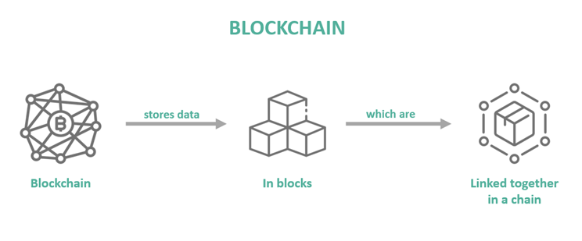
Blockchain
Ledger records transactions securely across multiple computers.
Distributed storage keeps copies across a network of nodes.
Blocks bundle transactions and update the ledger.
Blockchain ensures decentralization, security, and immutability.
Proof of Stake (PoS) is part of the consensus mechanism, which determines how new blocks are added to the blockchain

Slide 4
Proof of Work (PoW)
PoW is a consensus mechanism in the blockchain network to validate transactions, by miners solving complex problems
This takes significant computation power. The winner adds a new block on to blockchain. This is very energy intensive

Slide 5
Proof of Stake (PoS)
PoS accomplishes the same without requiring high computational power.
Instead of miners, the PoS uses validators to lock up a certain amount of cryptocurrency as a stake
The validators create new blocks based on the amount staked and other factors like staking duration
The more stake the validator has increases the chance of being selected
More energy efficient

Slide 6
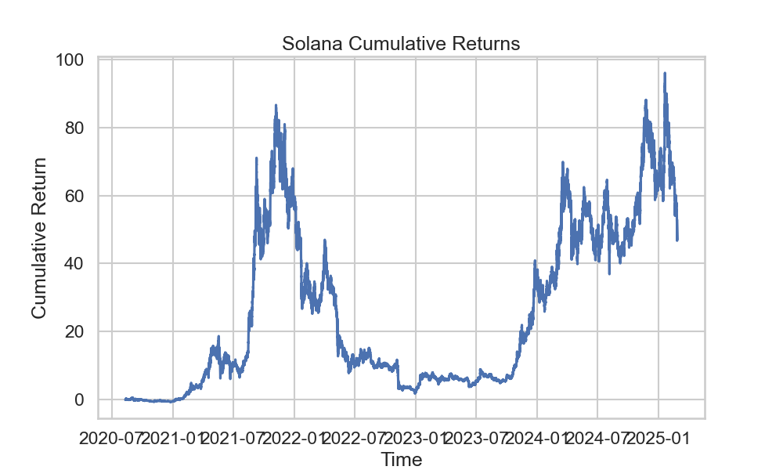
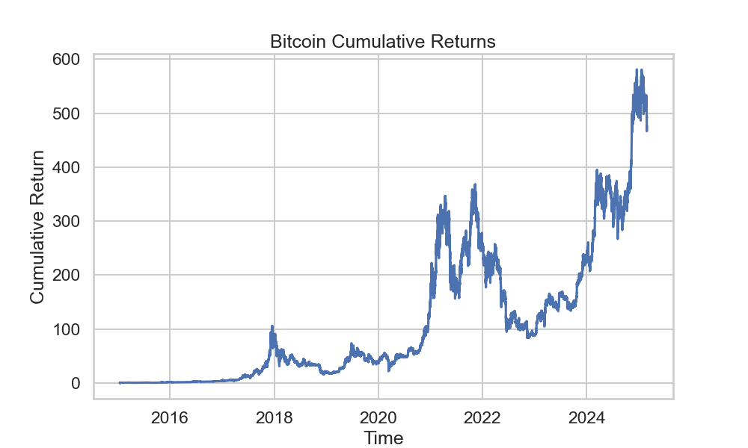
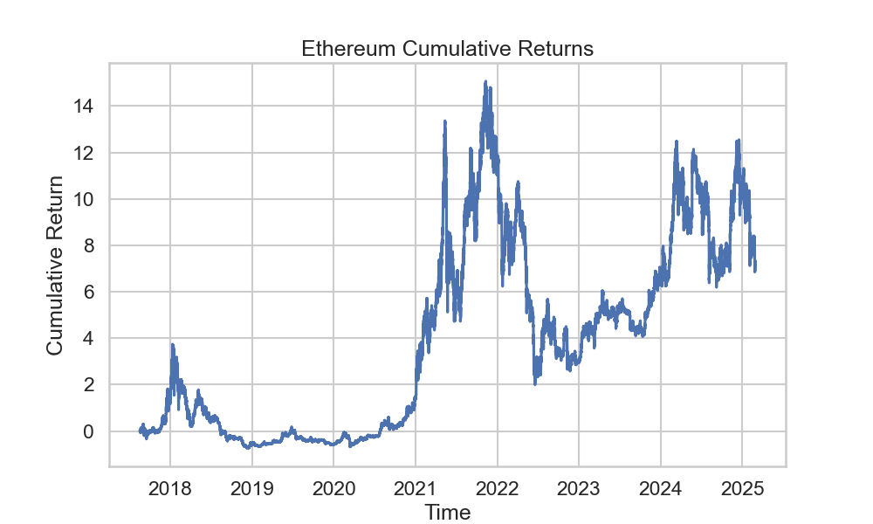
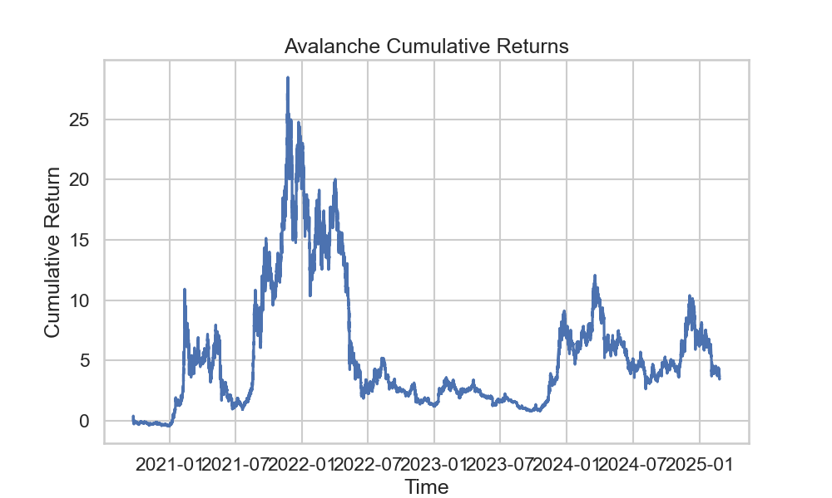
Proof of Work (PoW) vs Proof of Stake (PoS) Tokens
Bitcoin is one of the last remaining PoW tokens in the market, with many others (e.g. Ethereum) switching to PoS in the past 5 years. Thus, Bitcoin will be our main benchmark for PoW token performance.

Slide 7
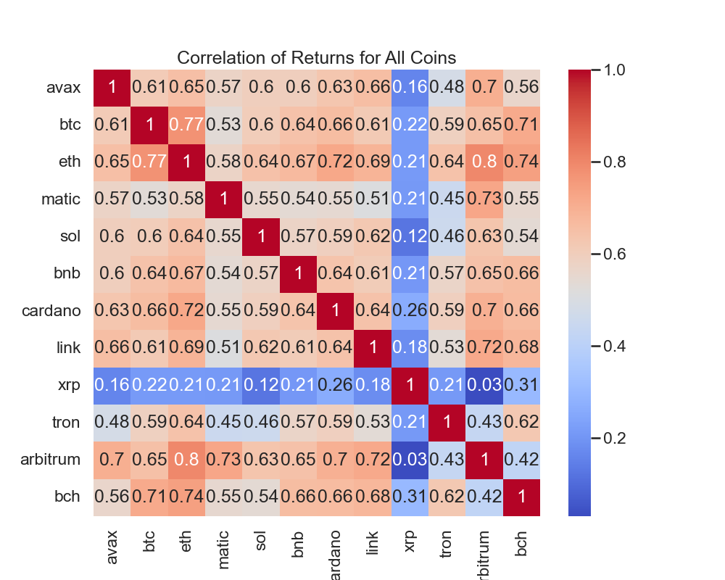
Correlation of Token Returns
We observe instances of uncorrelated returns between our tokens of interest. We interpret this as a positive signal for diversification in our strategy's ultimate portfolio allocation.

Slide 8
Motivation
Each asset class relies on fundamental data to determine proper valuation
Traditional prediction models for cryptocurrency are limited by focusing on either:
Technical indicators from price history (Parente et al., 2024)
On-chain fundamental data (Kim et al., 2022)
Our model bridges this gap by combining both data types and various methodologies from both papers
This integrated approach delivers more accurate buy/hold/sell signals for enhanced risk management and portfolio allocation
Fundamental Data Types
Equities | Fixed Income | Commodities | Crypto
Financial Statements | Interest Rates | Supply and Demand | On Chain Data

Slide 9
Hypothesis and Economic Rationale
On-chain data metrics are fundamentally related to the price of PoW coins due to the nature of the block processing system
Processing blocks in PoW systems is fundamentally related to energy consumption, making these metrics more useful in explaining the price of the digital asset
Processing blocks in PoS systems is fundamentally related to how much validators are staking
We hypothesize that because PoW on-chain metrics have a fundamental, contemporaneous relationship to asset price, there would not be as much predictive power looking into the future
Therefore, we believe PoS on-chain metrics have a lead-lag relationship to digital asset price, where the information contained in the on-chain metrics are not instantaneously reflected in digital asset price, but instead, it's leading the asset price
As a result, this lead-lag relationship can leave us a window to predict price directions in a profitable quantitative trading strategy

Slide 10
Investment Universe
Investment Securities
Data
Tron (TRON)
Arbitrum (ARB)
Avalanche (AVAX)
Polygon (MATIC)
Solana (SOL)
Technical Time Series
On Chain Block Data
Sourced from Dune API
PoS
Bitcoin (BTC)
Ethereum (ETH)
Binance (BNB)
PoW

Slide 11
Feature Space for On-Chain Data
Feature Name | Feature Description
Block Difficulty | Unitless, relative measure of computational power required to mine a new block on the blockchain.
Block Mint Reward | The reward (typically in the respective cryptocurrency) for successfully mining a new block.
Block Stripped Size | The size of a given block on the blockchain (in bytes) stripped of signature bytes (included for validation and do not include relevant metadata).
Total (Gas) Fees | Fees collected by miners to host transactions on a given block.
Block Transaction Count | The number of transactions which have occurred on a given block.
Block Weight | A measure of a given block's size and complexity, weighing in favor of blocks with more transactions on them.

Slide 12


Data Sources
Hourly (aggregated) On-Chain data was pulled from Dune
Hourly Price data was pulled from CoinAPI

Slide 13
Strategy Overview
Our strategy aims to leverage untransformed crypto data alongside constructed technical indicators (Fibonacci retracement, VWAP, RSI, etc.) to forecast strategy moves (buy, hold, sell).
These indicators will form the data inputs for a Neural Network (Multi-layer Perceptron; MLP) model, aiming to identify profitable patterns and weed out irrelevant features.

Slide 14
Parameterization
The model itself features the following parameters:
b := lookback window size
f := prediction horizon
x := lower prediction threshold
y := upper prediction threshold

Slide 15
Segmentation
Since crypto price data has significant time-varying volatility and dynamics that can negatively affect model training, we use a change point detection algorithm called PELT to mitigate these issues
PELT allows us to identify "change" points in the time-series data, which creates several segments with their own unique statistical dynamics
Using segmentation, we utilize a more robust methodology for normalization of non-stationary time-series data

Slide 16
Model Construction
Our model is a 4-layer Multi-layer Perceptron (MLP).
The input layer contains all the data discussed in our feature space
The output layer consists of three nodes (buy / sell / hold) which will be interpreted as our position actions.
The two hidden middle layers at present have an unspecified number of nodes, but this will be a parameter that we can fine-tune as we test our strategy's performance.
Notes:
Flow chart of NN

Slide 17
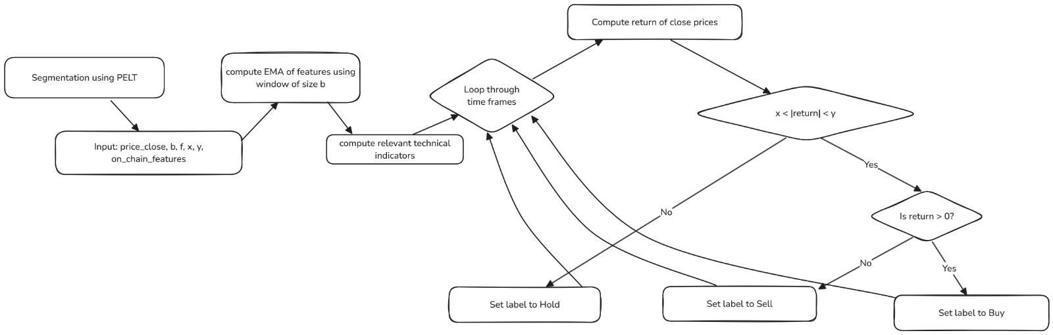
Model Pipeline

Slide 18
Backtesting - Assumptions
For our backtesting, we plan to include the following parameters:
f := trading fees
l := stop loss threshold
K := initial portfolio capital
This gives us the flexibility to closely replicate actual trading conditions and implement safeguards that may optimize performance in out-of-sample performance.
We also make the assumption that our movements have no market impact (prices are not retroactively changed due to our trades).
Notes:
Any other assumptions that we should be making when we backtest?

Slide 19
Risk Management & Portfolio Allocation
At present, our proposed model runs independently on each token, providing position actions (buy / sell / hold) at each time step. In order to combine these actions into a portfolio featuring all of the tokens, we choose to size our actions with two considerations:
We first assign an "accuracy score" to each token based on its performance during training. When entering a new position with any given token, its sizing will be proportional to its accuracy score.
When encountering successive "buy" classifications, we will increase the size of a tokens position in an exponentially decaying fashion. This allows us to take advantage of bullish predictions without banking our entire portfolio on a "hot streak" of any one token.
Our strategy also features a stop-loss condition, which is parameterized as discussed in the previous slide.

Slide 20
Sources
Kim, G., Shin, D.-H., Choi, J. G., & Lim, S. (2022). A deep learning-based cryptocurrency price prediction model that uses on-chain data. IEEE Access, 10, 56232–56247. https://doi.org/10.1109/ACCESS.2022.3177888
Parente, M., Rizzuti, L., & Trerotola, M. (2024). A profitable trading algorithm for cryptocurrencies using a neural network model. Expert Systems with Applications, 238, 121806. https://doi.org/10.1016/j.eswa.2023.121806

